Slide 1
War of Crystal

Slide 2
What is War of Crystal (WOC)?
War of Crystal is a online real-time strategy tower defense mobile game.

Slide 3
What is the background story of WOC?
Caitl'vik
N
W
E
S
Once upon the time, humans live on the Caitl'vik continent, they believe Caitl'vik continent is the only land on the world for centuries
until a great navigator found a new land where located at the south of Caitl'vik continent.

Slide 4
More importantly, humans found a crystal on the new land,

Slide 5
it contains a mystery power which allows humans to control the natural elements in the world such as fire, water, rock and even thunder which humans always fear. They call the power "magic".

Slide 6
Human start to migrate to the new land and extract magic crystal.

Slide 7

However, humans are not the first race to set their foot on this new land.

Slide 8
Due to the mass human activities on the new land, the inhuman creatures (orc, undead, elf and other inhuman creatures) which human call them "monster" feel angry

Slide 9
they start to attack human facilities and try to chase them away from the new land.

Slide 10
As the new land is still a mysterious place to human, humans cannot take the initiative to attack "monsters".

Slide 11

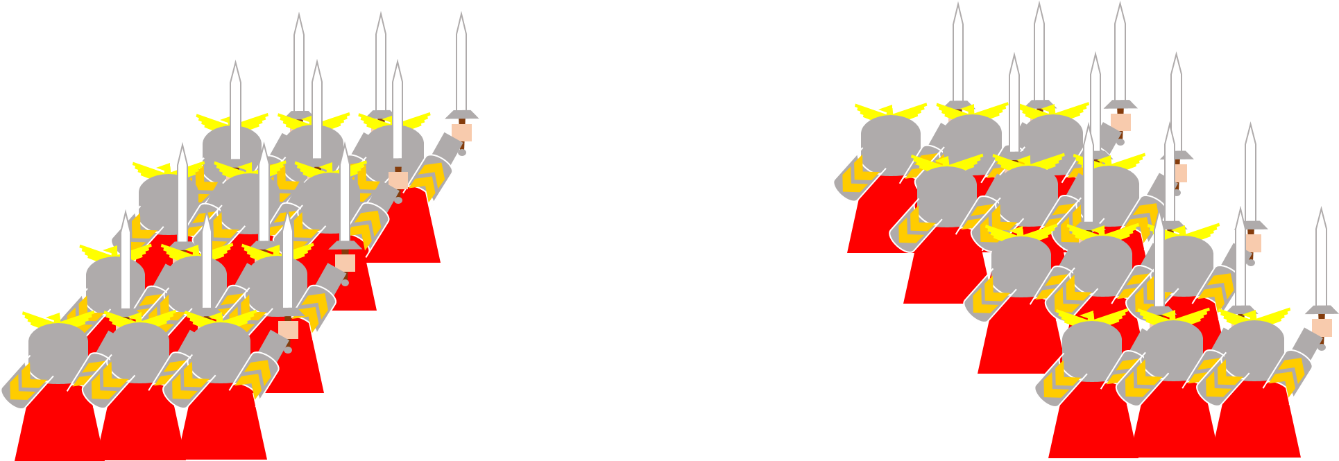
everyone knows humans are not so easy to surrender.

Slide 12
Therefore, the conflict between human as the defender and inhuman creatures as attacker begin and how the story goes, it is all for you to decide.

Slide 13

Who is WOC’s target audience?
Notes:
Since War Of Crystal is a real-time strategy tower defend online game, it requires quick logical thinking and fast body reaction respond from players, in addition , WOC contian more fantasy , cartoon and middle violence, therefore, it may not suitable for players who under 10 years old as their expectation of game is more casual and less stressful.

Slide 14

What does player do in WOC?
Choose your side
Player need to choose between defender and attacker in the library screen. (Player is able to change their role when not in the match making queue)
Defender
Attacker
Library
Home

Slide 15
What does player do in WOC?
Defender
Attacker
2. Select your warriors
Player need to select 6 unit cards from their class library to form a deck.
Library
Home

Slide 16
What does player do in WOC?
Finding opponents . . . . . .
3.Player will find an opponent who role as oppose class by match making system.
BATTLE!
Library
Home

Slide 17
What does player do in WOC?
4.After enter the gameplay screen, defender need to keep human outpost not destroyed by attacker within 2 minutes and attacker need to destroy human outpost within 2 minutes.

Slide 18
What does player do in WOC?
100%
5.Winner would receive 100% gold reward and loser only receive 25% gold reward in their respectively rank.
Victory point
25%
Victory point
R
R

Slide 19
Unique selling points
Players can either play as attack and defender
Unit cards talents system
Daily quest system
Regular events
Ranking and season system
Guild landmark system

Slide 20

Players can either play as attacker and defender
Breaking the traditional tower defense game mode and make a completely fresh gaming experience to players.
Unit cards for attacker and defender are completely different.
Most of defender unit cards are building.
Most of attacker unit cards are creature.
a

Slide 21
Unit cards talents system
LV.9
Players are allowed to upgrade their unit cards by collect certain amount of the same unit cards.
Talents will unlock when the unit card reach certain level and players are able to choose between 2 talents in each stage.
Each talents have different visual change to the unit cards to satisfy the player's visual sense.
LV.6
LV.3
LV.1

Slide 22
Daily quest system
Player will receive maximum 3 daily quests every 24 hours.
Daily quest will encourage players to be online everyday by provide considerable reward such as gold, recruit letter, unit cards, magic crystal, account EXP. Increase game stickiness especially for casual players.
R
R
EXP
EXP
EXP

Slide 23
Regular events
Regular event provides unique play modes with reward for solo players and player community respectively every 3 weeks. Increase game stickiness and encourage players to be online regularly.
Gold hammer, no gold finger
Mist season
Preserve season
?
?
Why I have this card?
Rash Hour
Unstable magic

Slide 24


Ranking and season system
Defender rank
Attacker rank
Victory rank
Event rank
Region rank

Slide 25
Guild landmark system
A player can establish or join a guild with other players.
chat and fight with other players within same guild.
Creator of the guild can take real-word location near his physical location as their guild base in the game. Other guilds can take the landmark away from originator by having a guild battle with them. Every guild member will need to fight with opponent guild member to get score. The guild which get higher total score will win and take the landmark.

Slide 26
Thank you

